Slide 1
Tutorial 2
Running programs to understand fork, wait and exec.

Slide 2
Recap
Running an .exe file creates a process ( A running program)
Consider a one CPU computer. Now at a single instance only a single process can run, then how does so many processes work together? Using timeshare
A Process has following components (Stored in PCB)
A unique identifier (PID)
Memory Space (Variables)
CPU Context (Registers, Pointers)
File Descriptors

Slide 3
States of A Process (Skip)
Running (Currently executing on CPU)
Ready (Waiting to be scheduled)
Blocked (Not ready to run, maybe waiting for input)
New (Being created, yet to run)
Dead (Terminated)

Slide 4
System Calls
Functions that have authority to run in kernel space
Fork(): Creates a new child process, All processes are created using forking a parent. First Parent is init process.
Wait(): Blocks a parent process until it’s child terminates
Exec(): Executes another program. (Our case another C file)
(Basically ek process dusre program ko execute karta hai)

Slide 5
During Fork
An exact copy in created of the PCB (means, memory space and pointers)
Memory space: (Agar variable fork se pehle created and its value a = 10, then both parent and child has a value equal to 10)
Pointer: (Jis line pe fork tha, naye child main bhi ussi line se hoga, not the start)
Only one gets cpu, sometimes it is the parent, sometimes it is the child. We never know who gets it
After fork, childs get independent (Meri Marzi 😤)

Slide 6
Show fork by running
https://colab.research.google.com/drive/1e4G8PfzlG8VhrsRYtQyQSaOxFNYzrT7J?usp=sharing

Slide 7
Wait
After a process is dead (i.e. exit() is called)
It goes into a zombie state and when the parent calls wait(), zombie child is cleaned up
Or other words, wait() blocks the parent to execute until its child dies.
// Application: way to hold the parent, so the child always execute first.

Slide 8
Exec - Family
Basically, if always creating a copy, then its usage and application is very less.
Remember child is independent after forking, so what it does, is become entirely different by calling exec()
# Easy words: Exec() allows running a different program, somewhere in memory.

Slide 9
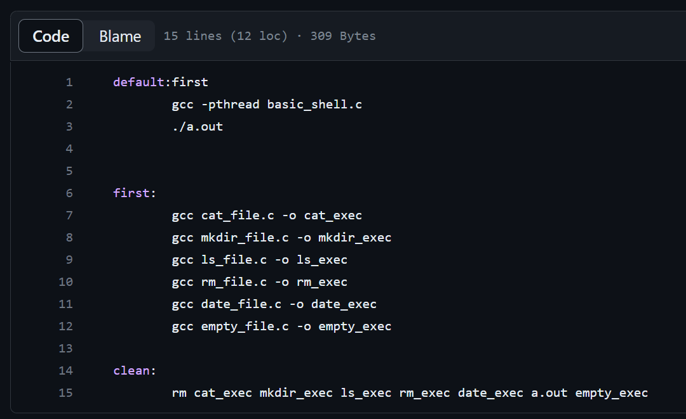
Makefile Snippet
a

Slide 10
Questions

